Slide 1



Excelerate
Data Visualization Associate Early Internship Final Presentation
From: Team 24
To Our Sponsor: Excelerate Team
Date Of Submission: 29-Sep-2025
WEEK 4 Deliverables
From: Team 24

Slide 2



Excelerate
Content
Index
01
02
03
04
Overview Of
Data
Exploratory Data Analysis
Data Cleaning
Data Validation
05
06
07
Dashboard walkthrough
Key Findings
Recommendations

Slide 3
Project Overview:
This Project provides an in-depth examination of three interconnected datasets—ApplicantData, OutreachData, and CampaignData—from the Illinois Institute of Technology’s admissions pipeline for AY2024. The exploratory data analysis (PRELIMINARY DATA EXPLORATION) uncovered key patterns, irregularities, and trends.
Exploratory Data Analysis:
The goal to gain an initial insight into a dataset by examining its structure, main features, and underlying patterns.
It is also essential for spotting anomalies, inconsistencies.

Slide 4
Applicant Data Set :
Top country: India with 12,234 records.
Instead of country names, there are email IDs and other invalid text values appearing in the “Country” column.
Phone Numbers vary in format: some 10 digits, some include country codes, others up to 13 digits.
Data Cleaning:
Duplicate Records
Missing and Invalid Country Values

Slide 5
Exploratory Data Analysis:
Outreach Data Set:
Reference_ID
Many applicants appear multiple times (multiple outreach attempts).
Campaign_ID
Most Successful is FA24IP (9,605 calls).

Slide 6
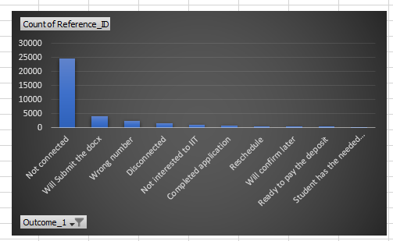
Call Outcomes Distribution

Slide 7
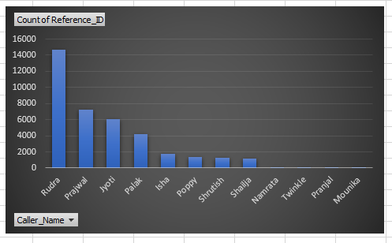
Agent Performance

Slide 8
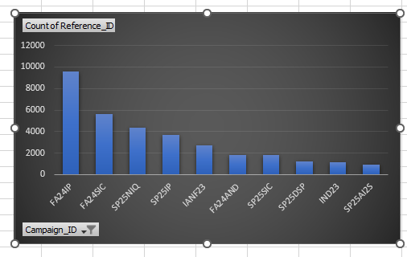
Campaign Effectiveness

Slide 9
Data Cleaning:
Duplicate Records
Issue: Many applicants (Reference_ID) appear multiple times due to repeated outreach attempts. While some duplication is valid (different call attempts).
Solution: Removed exact duplicate rows.
Call Outcomes (Outcome_1)
Issue: Some call outcomes are too detailed or inconsistent (e.g., “Student has the needed…”, “Will confirm later”).
Solution: Grouped outcomes into broader standardized categories.

Slide 10
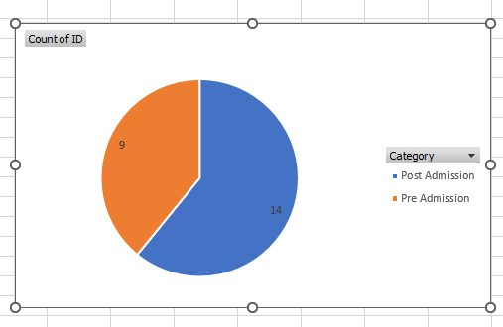
Exploratory Data Analysis:
Campaign Dataset:
Campaign Categories

Slide 11
Data Cleaning:
1. Campaign IDs (ID)
Issue: All 23 campaigns had unique IDs, but some contained a mix of upper/lowercase or extra spaces.
Solution.
7. Start Date (Start_Date)
Issue: Dates were stored as text in inconsistent formats (e.g., 3/20/2024 0:00, 9/11/2024 00:00).
Solution.
Master Table Creation:
To integrate all three datasets (ApplicantData, OutreachData, and CampaignData) into a unified structure, a Master Table was created in PostgreSQL. This table provides an end-to-end view of each applicant’s journey, linking their application details with outreach attempts and campaign information.

Slide 12
Data Connection:
connecting via Supabase, and Successfully tested static connection through Looker Studio (CSV upload).

Slide 13
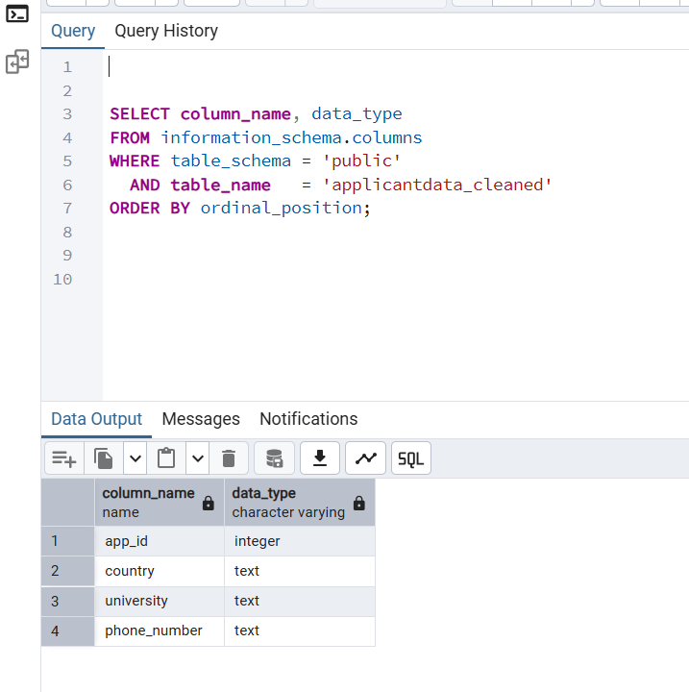
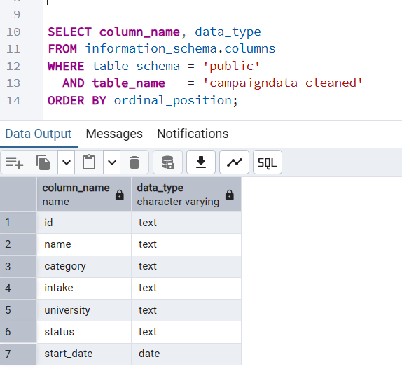
Data Consistency and Validation: Here we have 2 queries, verifying that data types and formats (e.g., dates, numeric fields) are consistent across all tables.

Slide 14
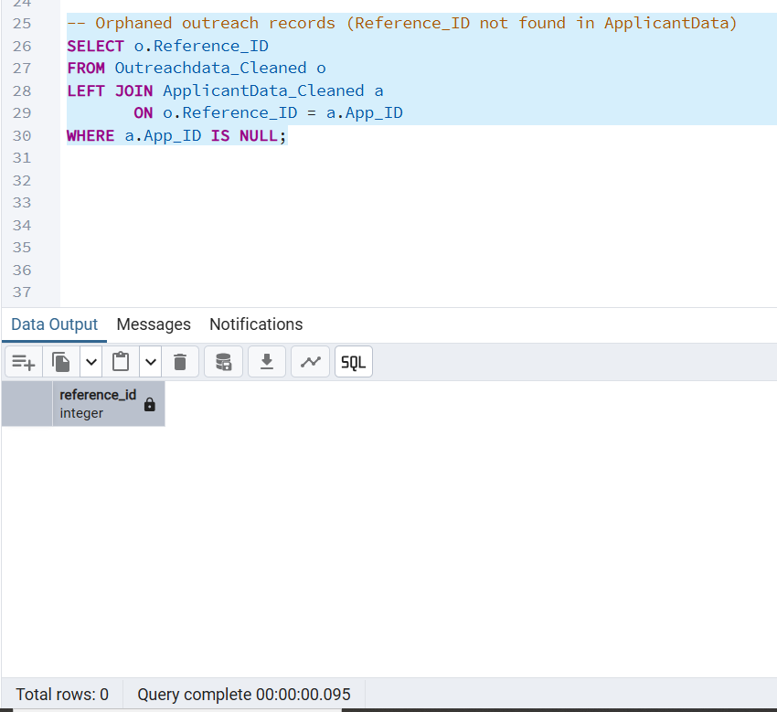
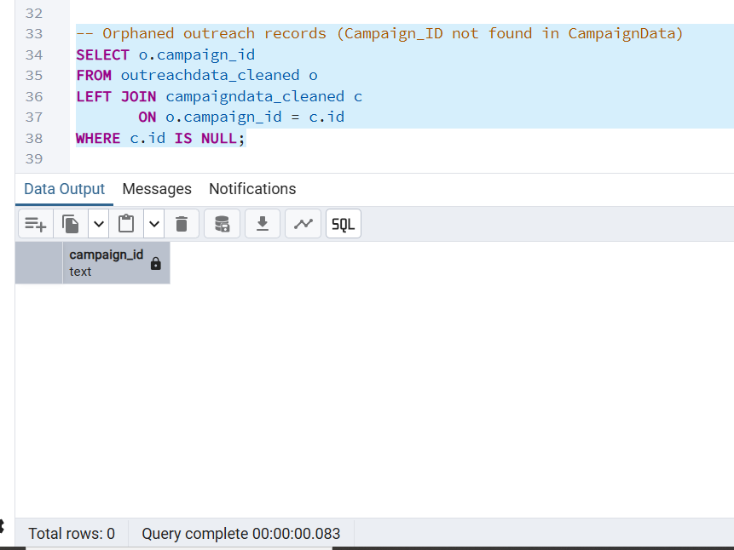
Data Consistency and Validation: Here we have 2 select queries, ensuring that key identifiers like Applicant IDs or Campaign IDs match across related tables (Outraech_Data), all good ( 0 Rows ).

Slide 15
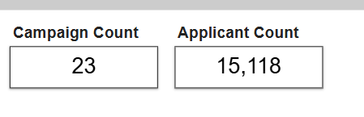
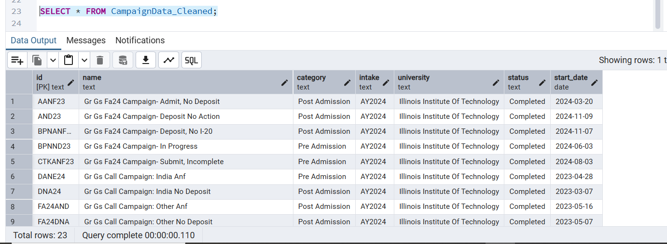
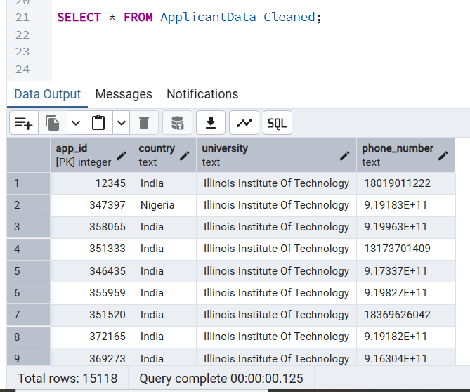



Then we have 2 queries to ensure that the Applicant count and Campaign count in the database match the dashboard, with no discrepancies.

Slide 16
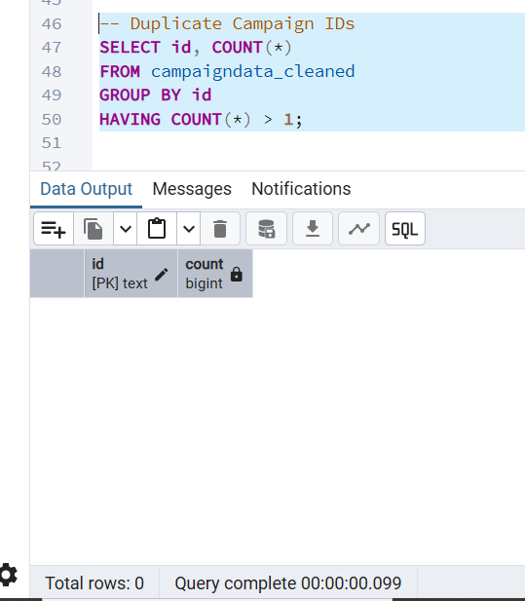
Here we have 2 select queries to ensure there are no duplicate records. Result: ( 0 rows ) ( No Duplicates ).

Slide 17
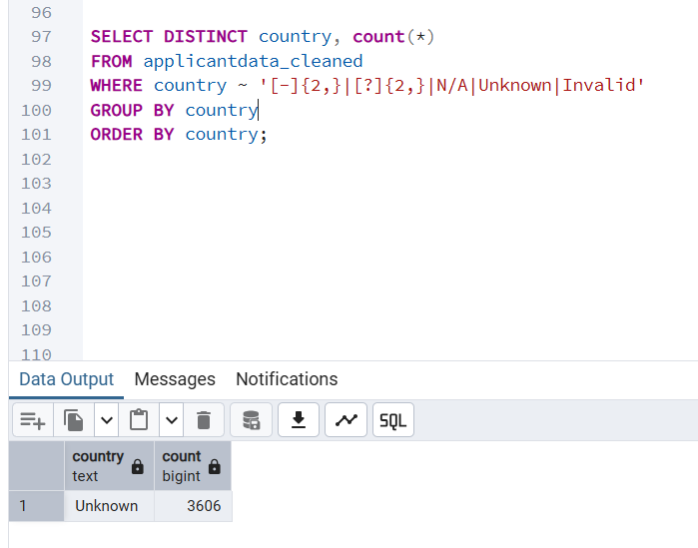
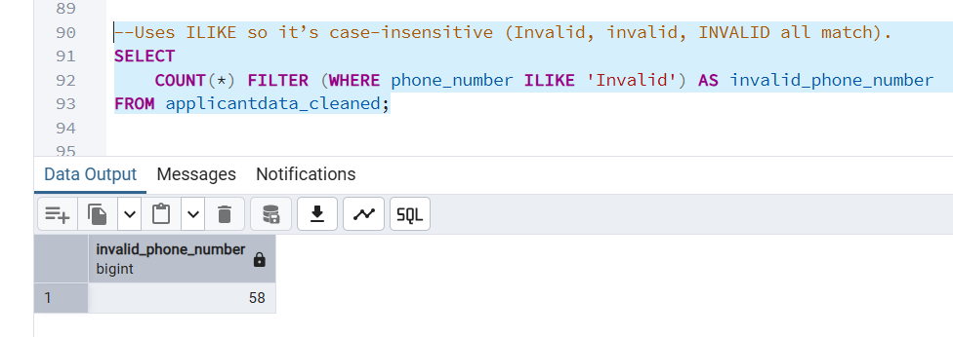
Here we have 2 queries to search more extensively for invalid data.

Slide 18
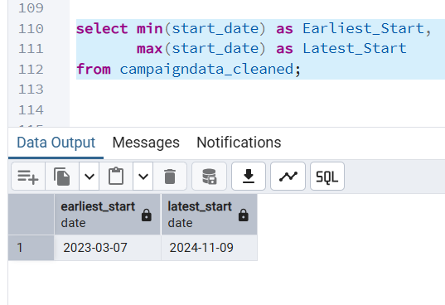
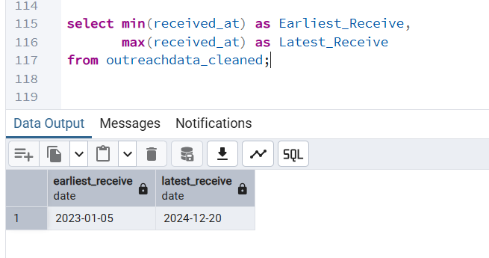
Here we have 2 queries, that shows there are calls attached to campaigns that hasn’t started yet!

Slide 19
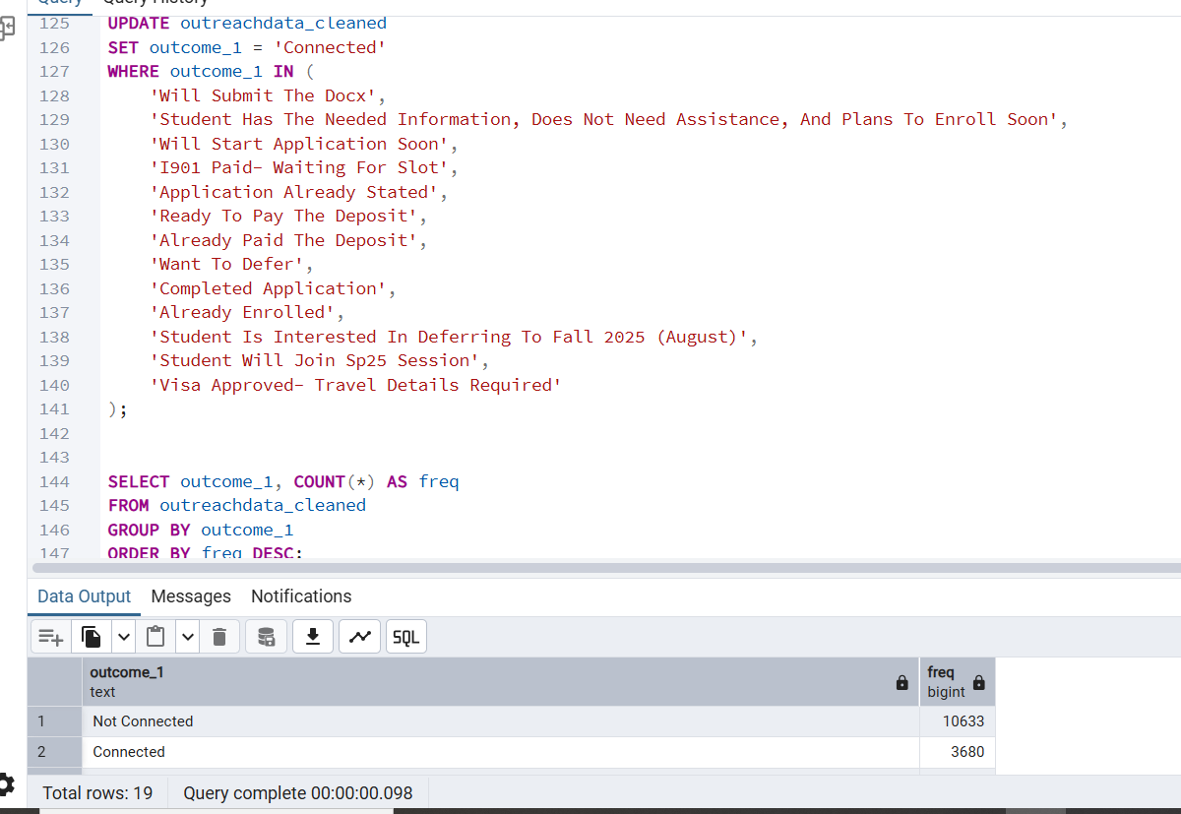
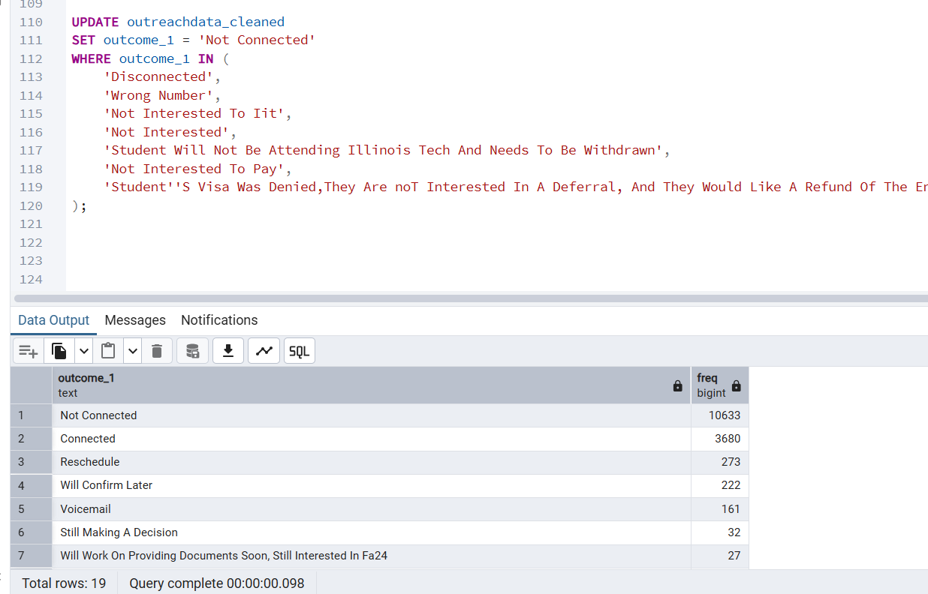
Here we discovered that the outcome_1 column values can be renamed for better outcome and accuracy.

Slide 20
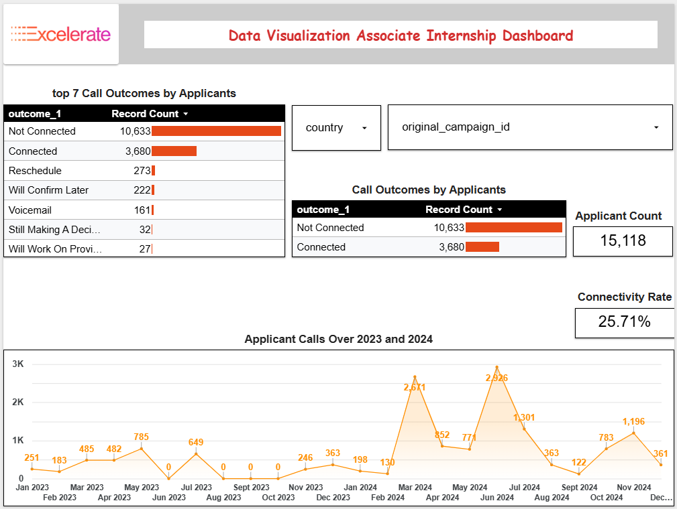
Dashboard Walkthrough:

Slide 21
Dashboard Walkthrough:
4-page interactive dashboard built in Looker Studio.
The first Page (Applicants Overview):
It highlights a low overall connectivity rate (25.7%), with most calls ending as Not Connected.
Applicant Count is 15,118
The second page ( Countries Performance ):
It displays the highest countries that has applicants

Slide 22
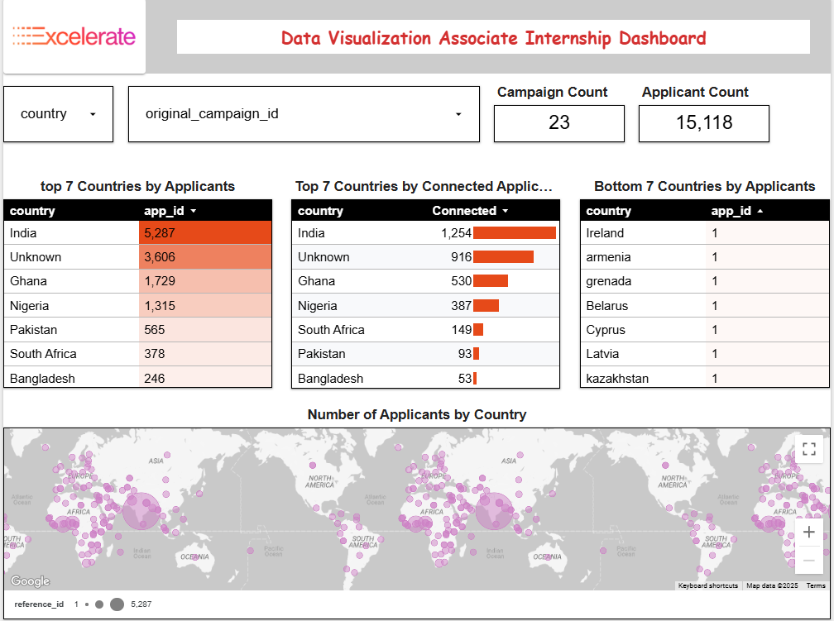

Slide 23
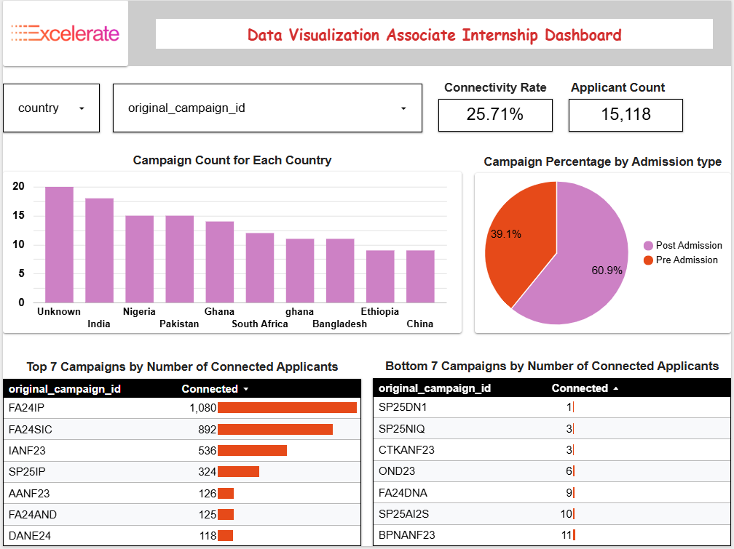
The third page ( Campaigns Performance ):

Slide 24
The third page ( Campaigns Performance ):
Which shows us the highest and lowest countries for campaign number.
a pie chart which displays the percentage of post- admission campaigns.
The top 2 campaigns are (FA24IP : 1,080 Applicant), and (FA24SIC : 892 Applicant).
The Fourth and last page ( Agents Performance ):
Which shows us that Rudra handled 4,840 calls over 2023, 2024,
Twinkle handled 26 calls over 2023, 2024,which is very low.
Looker Studio Dashboard Link

Slide 25
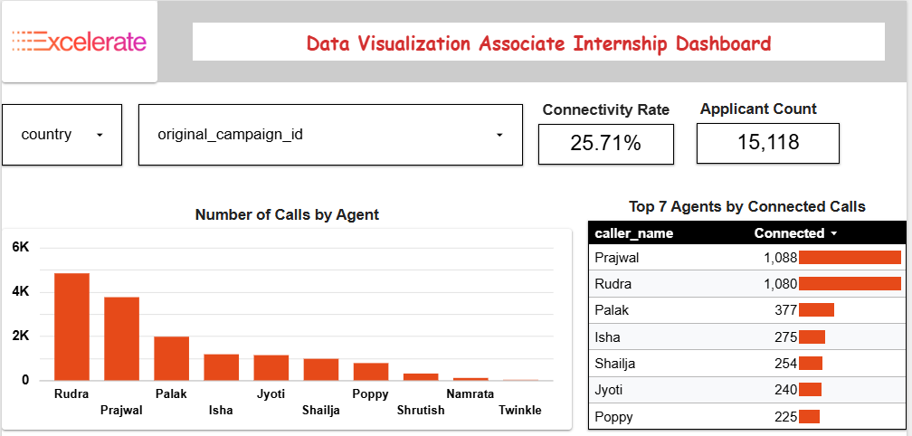

Slide 26

Key Findings
High Data Consistency – All tables have uniform data types and formats, ensuring accurate joins and reliable analysis.
‘Unknown’ Values – 3,606 unknown countries and 58 invalid phone numbers limit geographic and contact-based insights.
Early Call Activity – Calls recorded up to two months before campaigns hint at pre-launch engagement or date-entry errors.
The highest responses from applicants to the agents’ calls, was (not connected), and the Connectivity Rate is so low (25.71%) which certainly triggers a red flag.
The highest 5 countries that has applicants in other words calls are India, Ghana, Unknown, Pakistan, and Nigeria, so that tell us how much is our success in these countries, on the other hand, we have a lot of countries that has only 1 or 2 applicants like Irland, Armenia, Grenada.
Top 5 countries that has applicants whose Outcome Call is ‘Connected’ are ( India, Unknown, Ghana, Nigeria, and South Africa, on the other hand, there are a lot of countries with 0 applicants.

Slide 27
Key Findings
Rudra handled 4,840 calls over 2023, 2024 and Prajwal 3,762 calls, the highest 2 by far, on the other hand, Twinkle handled 26 calls over 2023, 2024, Namrata 110 calls, and Shrutish 309 which is very low.
Our time frame for calls is from 05-01-2023 to 20-12-2024, and in that time the highest number of calls were in 2024 (March by 2,671 calls),(June 2,926 calls), (Juley by 1,301 calls), and (November by 1,196 calls), on the other hand the least numbers were in 2023 ( June, August, September, October) all by (0 calls).
The top 5 campaigns are (FA24IP : 1,080 Applicant), (FA24SIC : 892 Applicant), (IANF23 : 536 Applicant), (SP25IP : 324 Applicant), and (AANF23 : 126 Applicant), on the other hand bottom 5 campaigns are (FA24DNA : 9 Applicant), (OND23 : 6 Applicant), (CTKANF23 : 3 Applicant), (SP25NIQ : 3 Applicant), and (SP25DN1 : 1 Applicant).

Slide 28

Recommendations
To address the findings and strengthen future operations, we propose:
📊 Data Quality & System Hygiene
Data Enrichment Efforts
Collaborate with the client/company to retrieve missing country and phone number details where possible.
Investigate Pre-Launch Calls
Conduct a deeper audit to confirm whether early call records reflect actual outreach or are errors.
Standardized Data Entry Protocols
Create and enforce a strict data-entry procedure to prevent future “Unknown” values and inconsistent date entries.
Regular Data Audits
Schedule routine consistency checks to ensure ongoing data quality and early detection of anomalies.

Slide 29
📞 Improve Applicant Connectivity
Problem:
Connectivity rate is critically low (25.71%).
Recommendations:
Agent Training & Scripts: Revise outreach scripts and provide targeted training to improve engagement.
Call at the right time: Align agent schedules with applicants’ local time zones.
Channel Diversification: Introduce WhatsApp, email, or SMS outreach to supplement calls.
Why it matters: Even a 5–10% lift in connectivity means thousands more engaged applicants.
🌍 Country Strategy
Focus on top markets: Double down on India, Ghana, Pakistan, Nigeria (optimize campaigns and staffing here).
create country-specific playbooks (local language scripts, ideal call windows, SMS content).
Competitor benchmarking: In low‑volume countries, analyze competitor companies’ marketing (channels, timing, offers) to identify gaps.

Slide 30
👩‍💼 Agent Performance
Immediate actions:
Rebalance workloads: reduce spare/underused agents; reassign top performers for high-value campaigns.
Reward quality, not just volume: Incentivize connected calls that lead to deposits/enrollments.
Performance management:
For top performers (e.g., Rudra): implement shadow sessions to extract best practices, share their techniques with the team.
Reporting:
Weekly agent dashboard: calls, connected rate, avg talk time for monitoring.
📅 Campaign-level recommendations
Prioritize high-performing campaigns for scale:
Expand outreach budget and channel mix for FA24IP, FA24SIC, IANF23, SP25IP (top 5 by applicants).
Replicate messaging/targeting for similar geographies/demographics where these campaigns succeeded.

Slide 31
📅 Campaign-level recommendations
Rescue low-performing campaigns:
Audit offer, and target lists for FA24DNA, OND23, CTKANF23, SP25NIQ, SP25DN1; run small experiments (re-targeting, different call scripts, localized creatives), or sunset them.
ROI tracking: Add a simple cost‑per‑connected‑applicant metric to compare campaigns fairly, if spend data available.
⏱ Timing & Seasonality
Peak staffing: Staff up in March, June, July, and November (historically highest call months).
Zero‑call months: Investigate why June–Oct 2023 had no calls; set alerts to prevent future gaps.
Seasonal campaigns: Align campaign launches with academic calendars (application deadlines, exam results, visa cycles).
A/B test : Call-time slots (morning vs evening local time) for top 5 countries to find optimal windows.

Slide 32
The End
Questions?

